Slide 2


Some personal background
PhD in mathematical statistics (TUDelft) (Estimating the extreme value index, tales of tails)
Methodologist since 1996, senior methodologist since 2018
Coordinating CBS research theme Information security (PPT, SDC)
Trainer (CBS, EMOS, ESTP, (inter)national)
Project leader of several European projects
Member of organizing committees of conferences and workshops on SDC
Member of European Expert Group on SDC

Slide 3
Privacy, disclosure and SDC
Peter-Paul de Wolf (Statistics Netherlands ) pp.dewolf@cbs.nl
September 2025

Slide 4
Concepts
Privacy
Anonymity
Security
People
Businesses
Data/Information
Notes:
Ask students (hands: who thinks that…):
Is Privacy a universal thing? Or is it relative?
Is Anonymity a universal thing? Or is it relative?
Are Privacy and Anonymity characteristics of People, Businesses or Data/Information?

Slide 5
Concepts
People/businesses
Privacy: “the right to be let alone”
Anonymity: “state of being non-identifiable”
Data/information
Confidentiality: “state of being kept secret or private”
Disclosure: “making (confidential) information known”

Slide 6
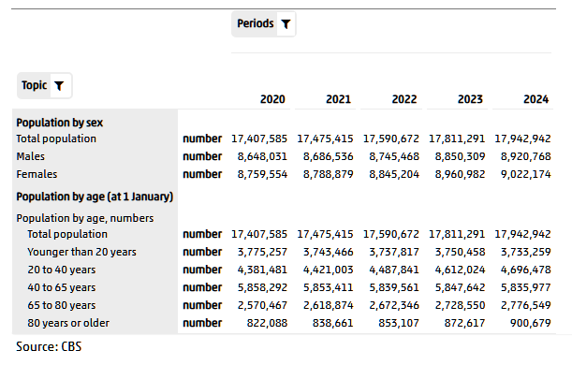
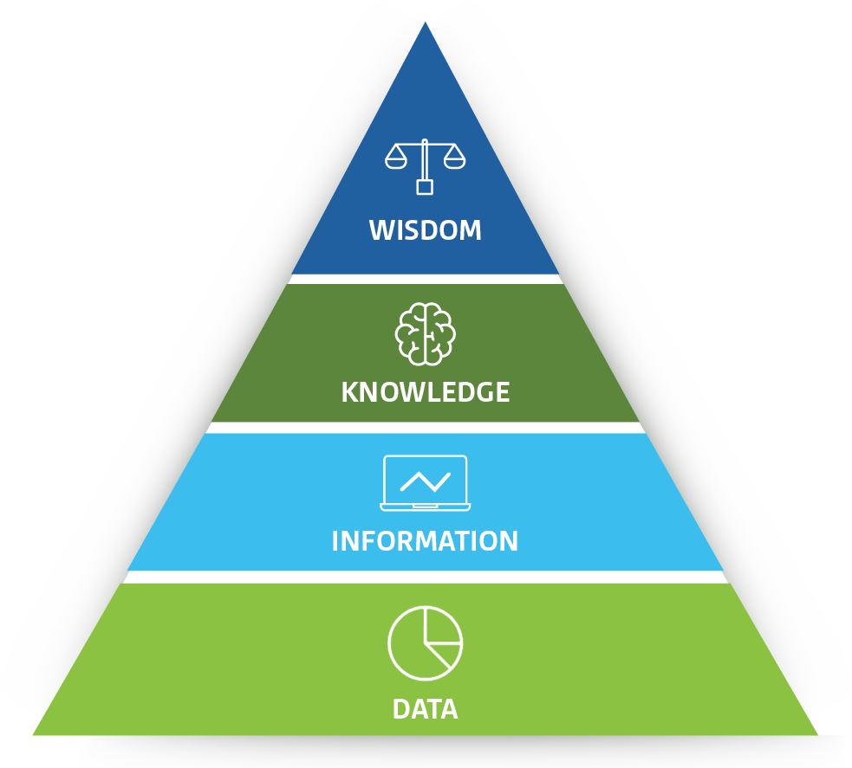
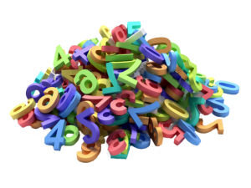
Concepts
Data enhanced with context
Numbers and facts
Notes:
In this talk I will concentrate on data and information (knowledge and wisdom are up to the users)
From now on with data I mean data and/or information

Slide 7
Concepts
Legal and moral obligation to “protect” data (respect privacy)
GDPR
CBS law (statistics law)
UN fundamental principle of official statistics
Codes of practice (ISI, Eurostat, CBS, …)
But also: own benefit!

Slide 8
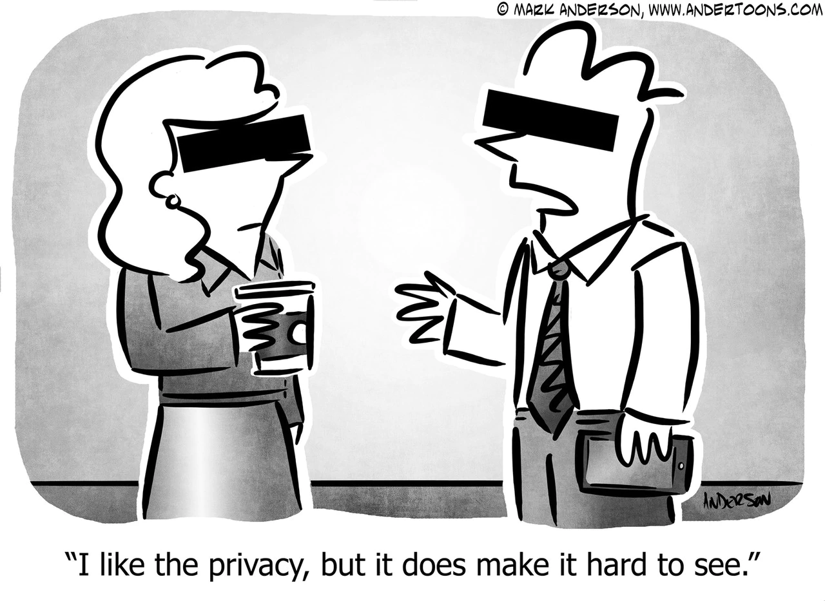
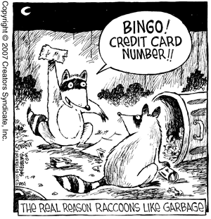
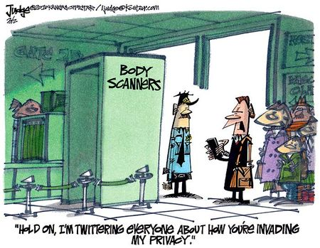
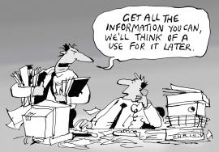
Risk/utility
Attacker scenarios
Public debate

Slide 9



Concepts
Different aspects:
Physical protection
Legal protection
Protection of statistical output => SDC (a.k.a. SDL)

Slide 10
Concepts
Statistical Disclosure Control (SDC)
Applied to statistical output
Microdata
Aggregated data (tables, …)
Models
Privacy Preserving Techniques (PPT)
Applied to data
Sharing data
Storing data
Working with data
PET: Privacy Enhancing Technologies

Slide 11





Concepts
Framework: five safes (ONS, 2003)
Trained and authorized users
Approved projects
Secure environment
Protected data
Screened and approved output
Safe people
Safe output
Safe projects
Safe data
Safe settings

Slide 12

Concepts
Providing (access to) data
Working with data
Publishing data
In a “safe” way
With sufficient “utility”
Within legal system

Slide 13


Concepts
controlling or limiting the risk of disclosure (not eliminating the risk)
any provision of useful statistical information necessarily entails a nonzero trailing risk of disclosing information on some individuals
Original data
Risk Utility
Disclosure risk
Maximum tolerable risk
Released data
No data
Data utility

Slide 14
Concepts
Risk of disclosure
Probability of disclosure
Impact of disclosure
 | Sensitivity (Impact scale) | 5 | 0 | 5 | 10 | 15 | 20 | 25 | 30 | 35 | 40 | 45 | 50
 |  | 4 | 0 | 4 | 8 | 12 | 16 | 20 | 24 | 28 | 32 | 36 | 40
 |  | 3 | 0 | 3 | 6 | 9 | 12 | 15 | 18 | 21 | 24 | 27 | 30
 |  | 2 | 0 | 2 | 4 | 6 | 8 | 10 | 12 | 14 | 16 | 18 | 20
 |  | 1 | 0 | 1 | 2 | 3 | 4 | 5 | 6 | 7 | 8 | 9 | 10
 |  |  | 0 | 1 | 2 | 3 | 4 | 5 | 6 | 7 | 8 | 9 | 10
 |  |  | Potential Disclosure Risk

Slide 15
Concepts
Risk of disclosure
Disclosure scenarios (phishing, spontaneous recognition, …)
Risk models (k-anonymity, l-diversity, DP, …)
Risk measures (p%-rule, threshold rule, …)

Slide 16
Statistical Disclosure Control (SDC)

Slide 17



SDC
Masked data
3-stages rocket
SDC
Methods (suppression)
data
Criteria (parameters)
Rules (legal requirements)

Slide 18
Statistical Disclosure Control (SDC)
Statistical output:
Microdata (PUF, SUF, ScUF)
Aggregated data (tabulated data, StatLine)
Analysis results (anything: models, modelparameters, visualisations, networks, regression parameters, tabulated data, …)

Slide 19
Microdata

Slide 20

Microdata
Soc. Sec. Nr. | Gender | Age class | Region | Education | Profession | Income | …
1927384123 | Female | 40-50 | The Hague (large) | Higher | Police officer | 39678 | …
1927384124 | Male | 30-40 | Urk (small) | Middle | Fisherman | 19634 | …
1927384125 | Female | 50-60 | Amsterdam (large) | Unknown | Mayor | 165321 | …
1927384126 | Male | 20-30 | Dordrecht (medium) | Lower | Plumber | 30961 | …
1927384127 | Female | 60+ | Staphorst (small) | Higher | Surgeon | 95876 | …
1927384128 | Male | 30-40 | Woensdrecht (small) | Higher | IT consultant | 44685 | …
1927384129 | Male | 60+ | Rotterdam (large) | Unknown | Surgeon | 99687 | …
1927384130 | Female | 20-30 | Borger (tiny) | Middle | Violin maker | 133658 | …
1927384131 | Female | 30-40 | Utrecht (large) | Lower | House cleaner | 14962 | …
… | … | … | … | … | … | … | …
… | … | … | … | … | … | … | …

Slide 21
Microdata
Legal basis to grant researchers access to microdata (CBS law)
Data leaving the institute:
PUF: Public Use Files (for ‘everybody’)
SUF: Scientific Use Files (for ‘trusted’ researchers)
Data not leaving the institute:
ScUF: Secure Use Files (for ‘trusted’ researchers)
On-site
Remote access

Slide 22
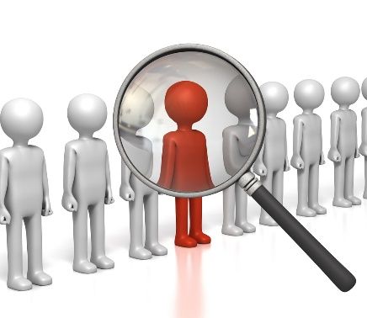
Microdata
Membership disclosure
Is it possible to derive that an identifiable unit is part of the microdata?
Identity disclosure
Is it possible to identify a unit in the microdata?
Attribute/inference disclosure
Is it possible to derive (a close estimate of) an attribute about an identifiable unit, using the microdata?

Slide 23
Microdata
Direct identifiers:
Unique value for each unit in the population
Person ID, chamber of commerce number, name+address, …
Indirect identifiers (quasi identifiers):
Not unique for each unit in the population, but in combination with other indirect identifiers will yield rare/unique unit(s)
Occupation, education, age, sex, region, business type, …

Slide 24

Microdata
Remove direct identifiers
Not sufficient: combination of indirect identifiers
Example
Occupation: Employee of Statistics Netherlands
Place of residence: Dordrecht
Level of education: PhD
Year of birth: 1967
That’s me!

Slide 25
Microdata
The real problem:
Identification could lead to disclosure of (sensitive) information
Soccer trainer in Amsterdam is identified in dataset
Additional info from that dataset: income + bonuses
Often: prevent identification to prevent disclosure of (sensitive) information

Slide 26
Microdata
Disclosure risk affected by
Number of (direct/indirect) identifiers
Number of categories per identifier
(Population) frequency of each category
Relations between identifiers
Quality of attacker’s a priori knowledge
Costs of identification

Slide 27
Microdata
Some (traditional) risk models for microdata
k-anonymity (identity disclosure)
At least k records with same score on a single n-dimensional “key”
k^{m}-anonymity (identity disclosure)
At least k records with same score on each m-dimensional “key”
l-diversity (attribute disclosure)
At least l different scores on attribute
Identification levels (identity disclosure)
Check only certain combinations of different levels of identification

Slide 28



Microdata
k-anonymity
How often in the microdata? Unique?
l-diversity
How divers in the microdata?

Slide 29
Microdata
Identification levels
Indirect identifiers differentiated into several nested identification levels, e.g.
Identifying (I)
Very identifying (V)
Extremely identifying (E)
E.g., based on how
visible
searchable
rare
I
V
E

Slide 30
Microdata
Then check certain combinations of identifying variables
Each combination of scores should occur at least n times in the population
E.g., check population frequencies in all combinations consisting of
identifying × very identifying × extremely identifying
I
V
E

Slide 31
Microdata
Identification levels:
Defined in terms of population frequencies
Need translation to microdata set in question (sample?)
Rule of thumb (relates population threshold to microdata set threshold)
Use available population information

Slide 32
Microdata
Model attacker’s behavior (scenario)
Simple scenario in case of k-anonymity, k^{m}-anonymity, identification levels:
Assume a record is randomly linked with one of the f_{k} possible matches, then probability of a correct match is 1/f_{k} (per record risk)

Slide 33
Microdata
So far individual risk
How about hierarchical data structures (e.g., households)?
Dependency between household members
Disclosure risk is risk that at least one household member is identified (and thus the household)
Household variables (e.g., household size) in key

Slide 34
Microdata
Household variables
Referring to household (e.g., hh-size, hh-type, hh-income)
Same for all members
Referring to individuals (e.g., religion)
High probability the same for all members

Slide 35
Microdata
Things to consider when releasing microdata:
Limit number of identifying variables
Outdate the microdata set
Randomize the order of the records
Provide only one microdata set per survey

Slide 36
Microdata
Consider to release mostly indirect regional variables and limit number of direct regional variables
Be very careful with
Possibility to match with other (open) data
Panel surveys
mutations/changes are very identifying

Slide 37
Microdata
 | PUF | SUF | ScUF
 | No influence | Contract + NDA | Contract + NDA
 | No influence | Limited influence | Intake
 | Limited influence | Some influence (contract) | RA-environment
 | Strictly protected data | Strongly protected data | Lightly protected data
 | Limited influence | Limited influence | Check for disclosure

Slide 38
Microdata
Rules for PUFs are much stricter than those for SUFs
SUF accompanied by legal measures
E.g.: only for statistical research no attempt to disclose data data disclosed by accident may not be misused no matching allowed results of research must be screened data must be destroyed after use possibility to take legal action after breach of confidentiality

Slide 39
Microdata
Thresholds on risk measures are much higher in case of PUFs (compared to SUFs)
In Dutch PUF:
Identification of units is very unlikely
No sensitive information is included!

Slide 40
Microdata methods

Slide 41
Microdata
Some (traditional) SDC methods:
Perturbative | Non-perturbative
Noise addition | (Sub)Sampling
Rounding | Recoding
Micro-aggregation | Top/bottom coding
Swapping/shuffling | Suppression
PRAM
Synthetic data

Slide 42
Microdata
First thing to do:
Remove all direct identifiers
… | Scientist | … | …
… | Trainer | … | …
… | Trainer | … | …
… | Trainer | … | …
… | President | … | …
… | Albert Einstein | Scientist | …
… | Peter-Paul de Wolf | Trainer | …
… | Violeta Calan | Trainer | …
… | Hans Haraldsson | Trainer | …
… | Guðni Thorlacius Jóhannesson | President | …

Slide 43
Microdata, non perturbative methods
(sub)sampling
Release only a sample of the records
Reduces the effect of response knowledge on original sample/file
Additionally remove targeted (rare) records?
NB: effect on sampling weights?

Slide 44
Microdata, non perturbative methods
Recoding
Combine categories into new category
Apply to all records in dataset
Goal: increase (population) frequency
… | Civil servant | Amsterdam | …
… | Civil servant | Rotterdam | …
… | Civil servant | Amsterdam | …
… | Fisherman | Rotterdam | …
… | Mayor | Amsterdam | …
… | Police officer | Rotterdam | …
… | Police officer | Amsterdam | …
… | Fisherman | Rotterdam | …

Slide 45
Microdata, non perturbative methods
Top- and bottom coding
Extreme scores may be identifying
Replace all scores above/below certain threshold with
That threshold
New category (threshold+)
Mean of values above the threshold
…

Slide 46
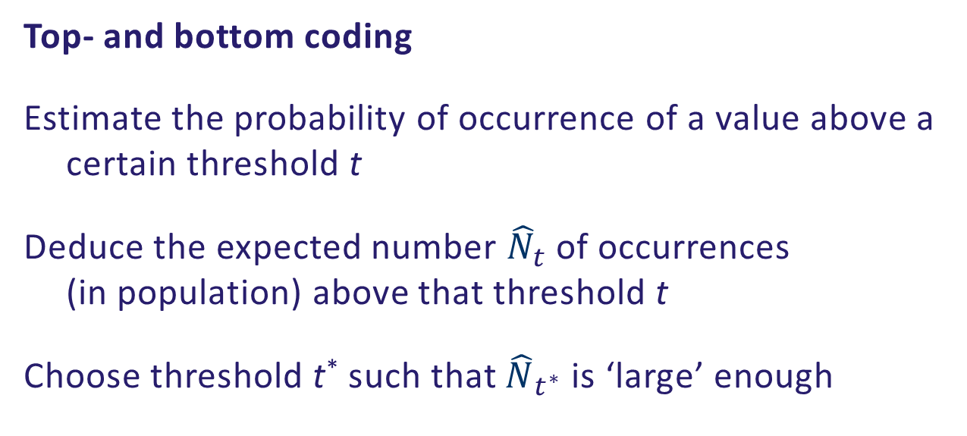
Microdata, non perturbative methods
Top- and bottom coding
Estimate the probability of occurrence of a value above a certain threshold t
Deduce the expected number ${\hat{N}}_{t}$ of occurrences (in population) above that threshold t
Choose threshold t* such that ${\hat{N}}_{t^{∗}}$ is ‘large’ enough

Slide 47
Microdata, non perturbative methods
Local suppression
Replace score by ‘missing’
Apply to targeted records only, one at a time
… | Mayor | Amsterdam | …
… | Police officer | Rotterdam | …
… | Police officer | Amsterdam | …
… | Fisherman | Rotterdam | …
… | NA | Amsterdam | …
… | Police officer | Rotterdam | …
… | Police officer | Amsterdam | …
… | Fisherman | Rotterdam | …

Slide 48
Microdata, non perturbative methods
Which variables to suppress?
Identification levels approach
Often multiple combinations with too low frequency
Minimize number of suppressions
Use ‘entropy’ (related to number of categories)
Use pre-set ‘priority’
k-anonymity approach
Related to frequencies in data set
Minimize number of suppressions
Satisfy k-anonymity in new dataset, where NA can be any value

Slide 49
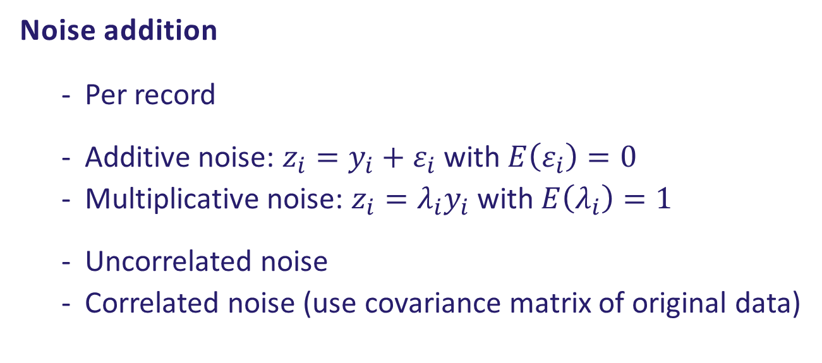
Microdata, perturbative methods
Noise addition
Per record
Additive noise: ${z_{i}=y}_{i}+ε_{i}$ with $E\left(ε_{i}\right)=0$
Multiplicative noise: ${z_{i}=λ_{i}y}_{i}$ with $E\left(λ_{i}\right)=1$
Uncorrelated noise
Correlated noise (use covariance matrix of original data)

Slide 50
Microdata, perturbative methods
Rounding
Applied to continuous variables
Replace by integer multiple of rounding base
Introduces uncertainty about true value
Reduces possibilities of linking/matching on the continuous variable

Slide 51
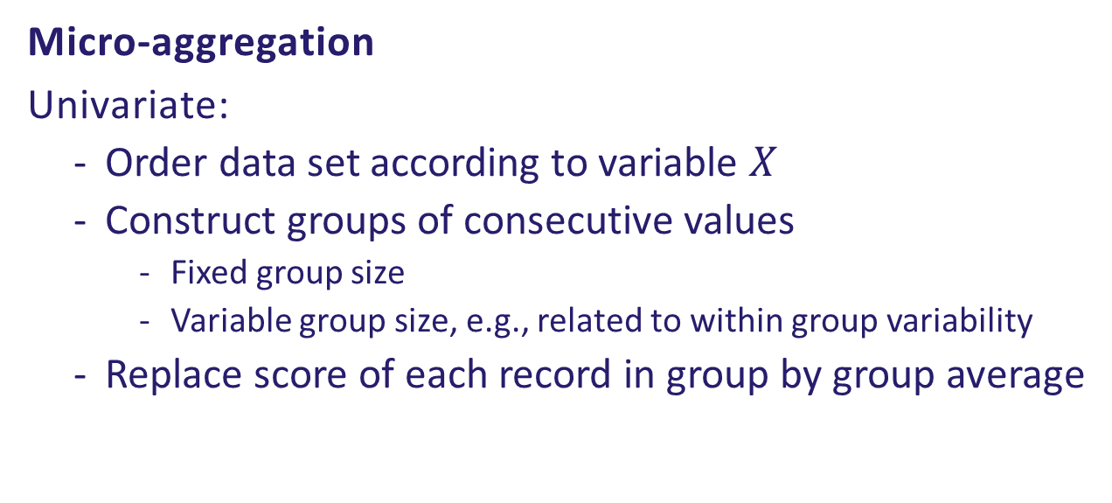
Microdata, perturbative methods
Micro-aggregation
Univariate:
Order data set according to variable $X$
Construct groups of consecutive values
Fixed group size
Variable group size, e.g., related to within group variability
Replace score of each record in group by group average
x_{i}
Fixed group size (3)
Variable group size

Slide 52
Microdata, perturbative methods
Data swapping
Basic idea:
Select two records r_{i} and r_{j}
Swap scores on (some) variable(s) of records r_{i} and r_{j}
r_{i}
… | Male | German | Trainer | …
… | Male | Dutch | Trainer | …
… | Female | Icelandic | Scientist | …
… | Male | Icelandic | Trainer | …
… | Male | Icelandic | President | …
… | Male | German | Scientist | …
… | Male | Dutch | Trainer | …
… | Female | Icelandic | Trainer | …
… | Male | Icelandic | Trainer | …
… | Male | Icelandic | President | …
r_{j}

Slide 53
Microdata, perturbative methods
Several selection mechanisms possible:
Random (SRS, STSI, …)
(Approximately) preserving certain statistics
Rank swapping
Targeted Record Swapping

Slide 54
Microdata, perturbative methods
PRAM
Post RAndomization Method
Applied after data collection
Per record, change score on categorical variable to another score, with known (transition) probabilities
Compare to
Randomized Response (applied before collection)
Misclassification (with unknown transition probabilities)

Slide 55

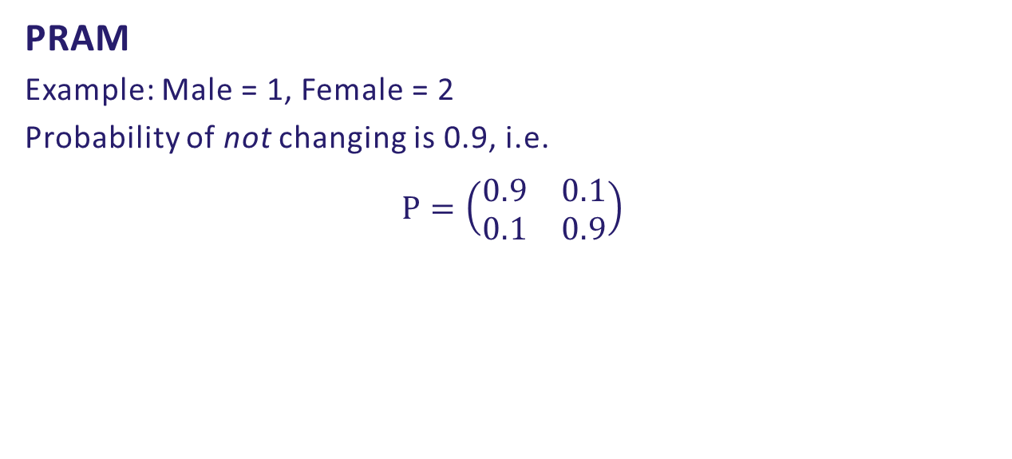
Microdata, perturbative methods
PRAM
Example: Male = 1, Female = 2
Probability of not changing is 0.9, i.e.
$$P=\left(\begin{matrix}0.9 & 0.1 \\ 0.1 & 0.9\end{matrix}\right)$$
… | Male | German | Scientist | …
… | Male | Dutch | Trainer | …
… | Male | Icelandic | Trainer | …
… | Male | Icelandic | Trainer | …
… | Male | Icelandic | President | …
… | Male | German | Scientist | …
… | Male | Dutch | Trainer | …
… | Female | Icelandic | Trainer | …
… | Male | Icelandic | Trainer | …
… | Male | Icelandic | President | …
… | Male | German | Scientist | …
… | Male | Dutch | Trainer | …
… | Male | Icelandic | Trainer | …
… | Male | Icelandic | Trainer | …
… | Female | Icelandic | President | …

Slide 56
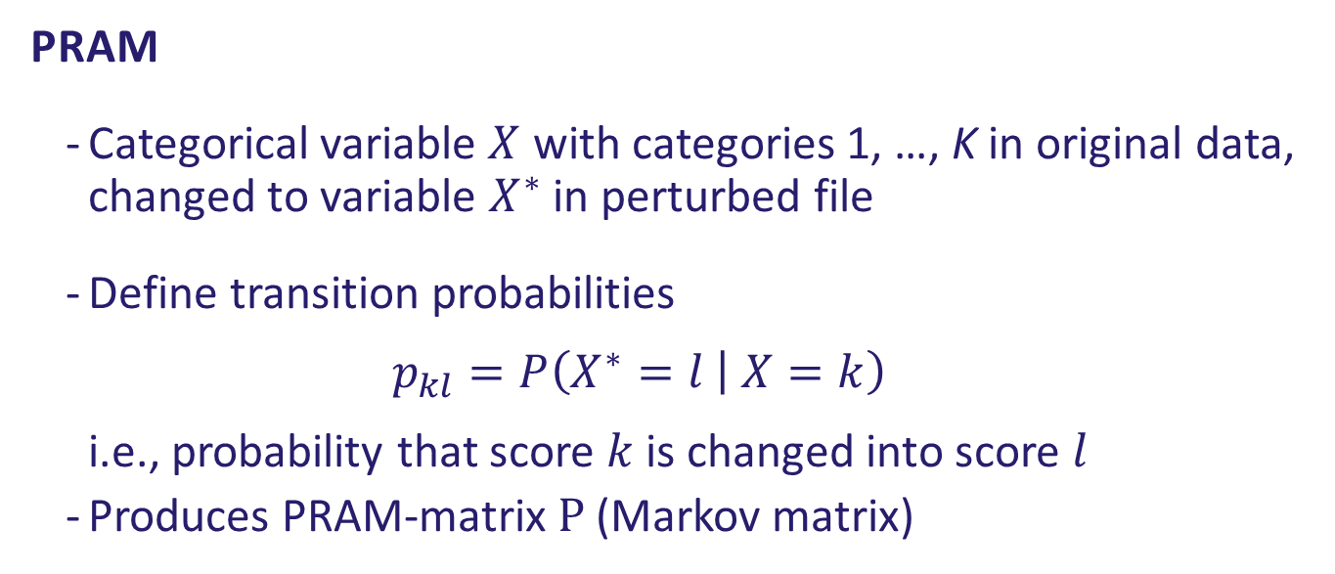
Microdata, perturbative methods
PRAM
Categorical variable $X$ with categories 1, …, K in original data, changed to variable $X^{∗}$ in perturbed file
Define transition probabilities $p_{kl}=P\left(X^{∗}=l | X=k\right)$ i.e., probability that score $k$ is changed into score $l$
Produces PRAM-matrix $P$ (Markov matrix)

Slide 57
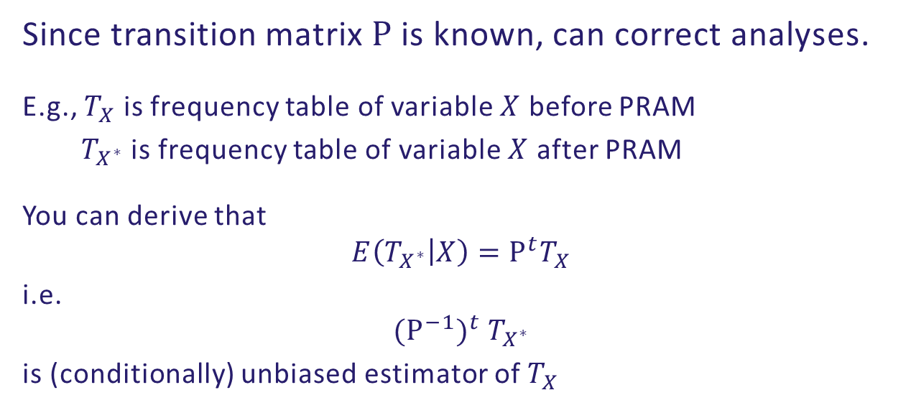
Microdata, perturbative methods
Since transition matrix $P$ is known, can correct analyses.
E.g., $T_{X}$ is frequency table of variable $X$ before PRAM
$T_{X^{∗}}$ is frequency table of variable $X$ after PRAM
You can derive that
$$E\left(T_{X^{∗}} | X\right)=P^{t}T_{X}$$
i.e.
$${(P^{−1})}^{t} T_{X^{∗}}$$
is (conditionally) unbiased estimator of $T_{X}$

Slide 58
Microdata, perturbative methods
Things to think about when choosing transition probabilities:
Try to preserve certain statistics (in expectation)
Exclude illogical changes
e.g., set transition probability unmarried + age < 5 to widowed + age < 5 equal to 0

Slide 59
Microdata, perturbative methods
Note:
Each time PRAM is applied you get different outcome
Hence, ‘simple’ risk measures do not work
Possible to adjust analyses, but burden to user!

Slide 60
Microdata, synthetic data
Closely related to (multiple) imputation
Suggested in 1993 (Rubin: fully synthetic, Little: partially synthetic)
Produce data with smaller risk of disclosure compared to original raw data
“Too early”
Re-discovered
More powerful CPUs
More applications (ML, AI, images, augment data, …)
Escape the GDPR?

Slide 61
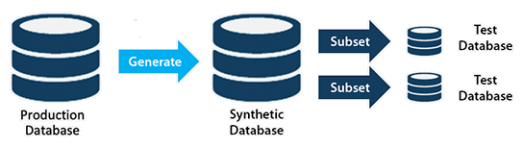
Microdata, synthetic data
Three steps process:
Estimate data generating process/model (CART, GAN, Diffusion models, LLM, …)
Simulate observations from that data generating process
Release (a subset of) the simulated data

Slide 62
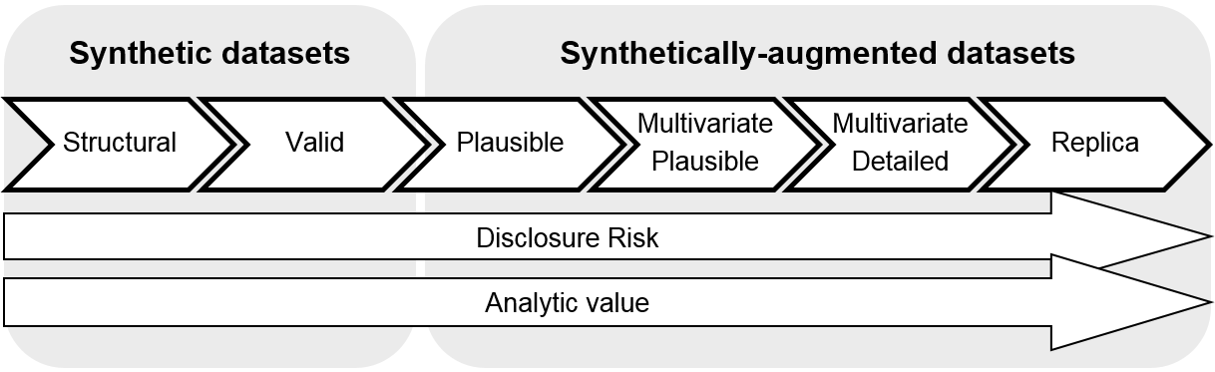

Microdata, synthetic data
Intuitively:
More accurate model => closer to original data => more utility AND higher disclosure risk
Start with aggregated data or with microdata?

Slide 63
Microdata, synthetic data
Fully synthetic microdata:
Identity disclosure no/negligible risk
Attribute/inferential disclosure risk
International findings: (e.g., Shlomo (2022))
disclosure risk measures for synthetic data after its generation are still ad‐hoc, and a more formal framework is needed for measuring the risk of attribute disclosure
Natalie Shlomo. (2022). How to measure disclosure risk in microdata? The Survey Statistician 86, 2 (2022), 13–21.

Slide 64
Microdata, synthetic data
Important:
Intended use (testing, preparation, analysis, augmentation, training ML, …)
Attacker scenario (when used for training ML: model inversion attack)

Slide 65



Microdata
To check risk measures and apply methods:
sdcMicro (R-package)
µ-argus (stand alone software)
synthpop (R-package)
metasyn (Python package)
https://github.com/sdctools

Slide 67
Concepts
CBS law (section 37):
The data received by the director general in connection with the performance of his duties to implement this act shall be used solely for statistical purposes.
The data referred to in the first subsection shall not be provided to any persons other than those charged with carrying out the duties of the CBS.
The data referred to in the first subsection shall only be published in such a way that no recognisable data can be derived from them about an individual person, household, company or institution, unless, in the case of data relating to a company or institution, there are good reasons to assume that the company or institution concerned will not have any objections to the publication.

Slide 68
Concepts
CBS law (section 37):
The data received by the director general in connection with the performance of his duties to implement this act shall be used solely for statistical purposes.
The data referred to in the first subsection shall not be provided to any persons other than those charged with carrying out the duties of the CBS.
The data referred to in the first subsection shall only be published in such a way that no recognisable data can be derived from them about an individual person, household, company or institution, unless, in the case of data relating to a company or institution, there are good reasons to assume that the company or institution concerned will not have any objections to the publication.

Slide 69
Concepts
CBS law (section 37):
The data received by the director general in connection with the performance of his duties to implement this act shall be used solely for statistical purposes.
The data referred to in the first subsection shall not be provided to any persons other than those charged with carrying out the duties of the CBS.
The data referred to in the first subsection shall only be published in such a way that no recognisable data can be derived from them about an individual person, household, company or institution, unless, in the case of data relating to a company or institution, there are good reasons to assume that the company or institution concerned will not have any objections to the publication.

Slide 70
Concepts
CBS law (section 37):
The data received by the director general in connection with the performance of his duties to implement this act shall be used solely for statistical purposes.
The data referred to in the first subsection shall not be provided to any persons other than those charged with carrying out the duties of the CBS.
The data referred to in the first subsection shall only be published in such a way that no recognisable data can be derived from them about an individual person, household, company or institution, unless, in the case of data relating to a company or institution, there are good reasons to assume that the company or institution concerned will not have any objections to the publication.

Slide 71
Privacy Preserving Techniques

Slide 72
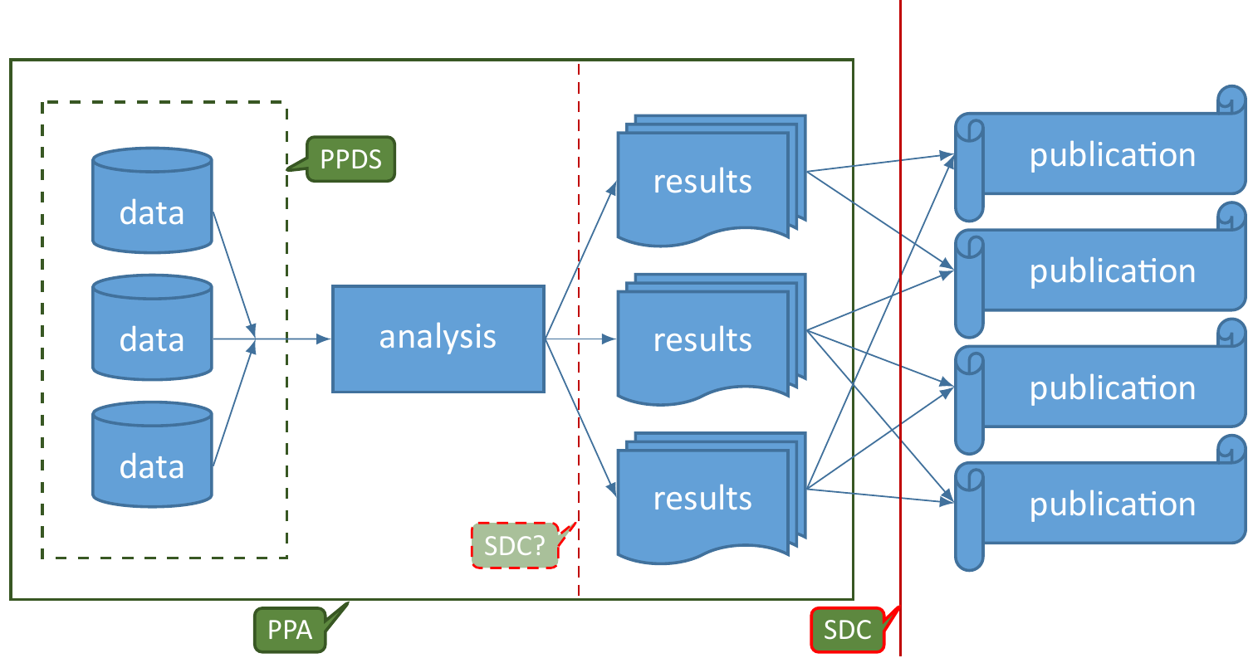
PPT and SDC

Slide 73
PPT
Privacy Preserving Techniques/Technologies (PPT)
(like secure MPC, homomorphic encryption, secret sharing, …)
Privacy Preserving Data Sharing (PPDS)
Privacy Preserving Analytics (PPA)

Slide 74
PPT
Relatively new at CBS
So far only PoCs targeted at technical aspects:
CARRIER
University Maastricht, MUMC+, SURF, Zuyderland Hospital, CBS
Modelling risks related to cardio-vasculair diseases
MPC + federated learning

Slide 75
PPT
CBS, RIVM, Roseman Labs
RIVM casus (food consumption (sugar, fat, …))
sMPC (homomorphic encryption)
“regular” statistical methods (Crandas: sort of secure pandas (Python))
Notes:
RIVM data combined with CBS data via a Virtual Data Lake at a node at Roseman Labs

Slide 76

PPT
Multiparty computation
Add noise to the data before sharing the data
Divide the data into ‘secret shares’ and distribute these across parties
Notes:
Multiparty computation is a toolbox, a collection of various methods, which allow multiple data owning parties to analyse their data.
There are various solutions to compute e.g., scalar dot product, linear regression, maximum of a set,

Slide 77
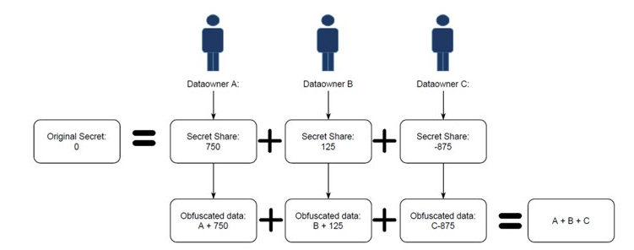
Secret sharing
Notes:
In this case an external commodity server generates the secret shares

Slide 78
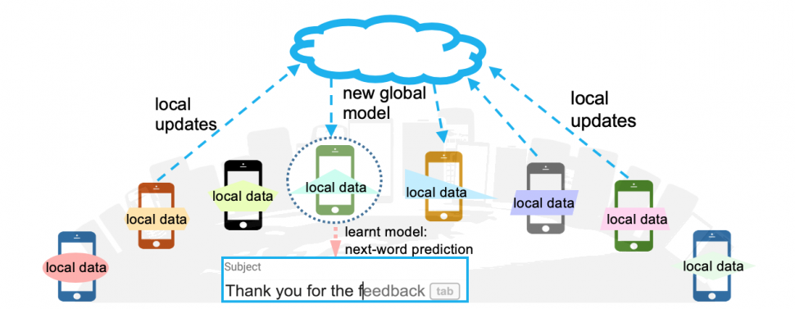
PPT
Federated learning
Daalen, F. et al (2024) Federated Bayesian Network Ensembles 10.1109/FMEC59375.2023.10306230

Slide 79
PPT
Trusted third party
Encrypted data
NSI
A party without interest in the result

Slide 80
PPT
Attacker scenarios:
Partners
Honest but curious/Semi honest
Malicious
Outsiders e.g., hackers, eavesdropping
Risk versus impact

Slide 81
PPT
Increase trust
Scientifically ‘hot topic’
But also dominated by commercial parties
Difficult for exploratory analyses
No ‘of the shelf’ options
See also https://unstats.un.org/bigdata/task-teams/privacy/UN%20Handbook%20for%20Privacy-Preserving%20Techniques.pdf

Slide 82

Privacy, security and disclosure are related but not the same
Statistical Disclosure Control is relevant to protect (statistical) data/information and all students should know about it
Privacy Preserving Techniques are relevant to share and analyse “sensitive” data
There is still a lot of research to do in SDC and PPT in relation to Official Statistics

